Slide 1

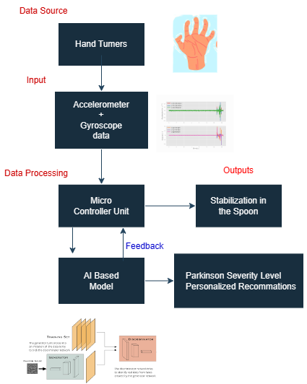
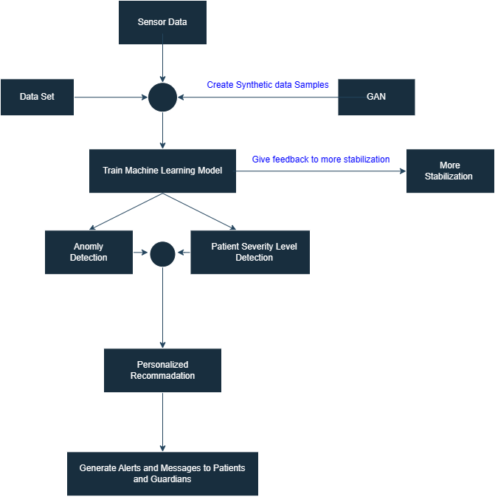


Basic Outline of the Machine Learning Implementation of the Spoon
Notes:
Here is a basic outline of how machine learning was implemented for the dynamic positioning spoon
The final goal is to utilize the machine learning approach to achieve greater stabilization in spoon positioning, while also assessing the severity level of the patient's condition and providing personalized recommendations.

Slide 2

Getting and storing the data.
Data corresponding to high tremors.
Data corresponding to low tremors.
AccX | AccY | AccZ | GyroX | GyroY | GyroZ | Status
-4440 | 1420 | 13652 | -1152 | 822 | 4330 | High
-3156 | 1188 | 16104 | -1152 | -1937 | -4509 | High
2880 | 10856 | 22264 | -1168 | 1146 | 1508 | High
-4384 | 272 | 13576 | -1152 | 801 | 1946 | High
3388 | 10732 | 24992 | -1168 | 1024 | -3346 | High
-4636 | 1148 | 13852 | -1152 | 201 | 582 | High
2240 | 8740 | 20916 | -1168 | -1574 | -3044 | High
AccX | AccY | AccZ | GyroX | GyroY | GyroZ | Status
-3044 | 8120 | 19064 | -976 | -677 | 2920 | low
-2492 | 4576 | 17728 | -928 | -1850 | 37 | low
-3184 | 4440 | 16392 | -960 | 1046 | 1301 | low
-3276 | 5332 | 16664 | -960 | 1745 | 4382 | low
-5008 | 6276 | 17764 | -928 | 2511 | 3163 | low
-5124 | 5476 | 16000 | -944 | -771 | 955 | low
-4860 | 6064 | 16712 | -944 | 549 | -1494 | low
Save in to the Excel File
Acc & Gyro Data From
MPU6050
Labeling data according to the tremor level

Slide 3
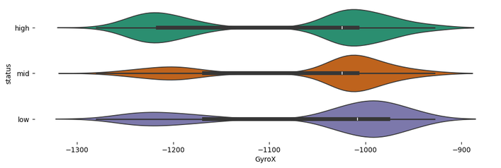

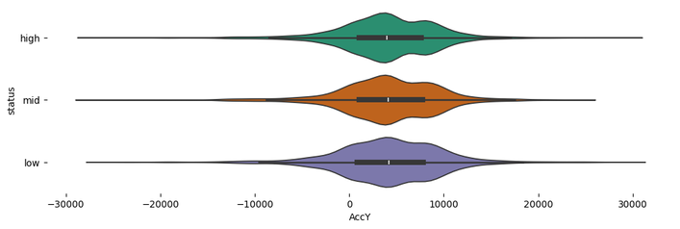
Synthetic Data Generation
AccX | AccY | AccZ | GyroX | GyroY | GyroZ | Status
-2784 | 7968 | 16656 | -1008 | 330 | -570 | high
-752 | 7132 | 13968 | -960 | 2190 | 124 | low
1328 | 8716 | 15740 | -1056 | -2455 | -2136 | high
-3412 | -796 | 6260 | -1216 | 10974 | -4703 | high
-4092 | -404 | 17900 | -1216 | -2942 | 3292 | high
-3628 | 8636 | 16812 | -976 | -575 | -285 | mid
-3556 | 6956 | -13656 | -1008 | 606 | 968 | high
-1724 | 176 | 16296 | -1216 | 1069 | 448 | high
Generated
synthetic
data
CTGAN
Recorded Data
Generate Syenthetic Data
Table Evaluater
Evaluate Generated Synthetic Data

Slide 4
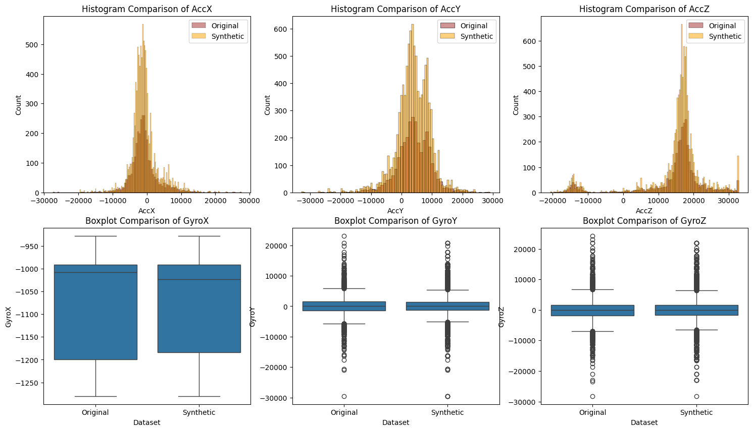
Comparision Between Original Vs Synthetic data

Slide 5
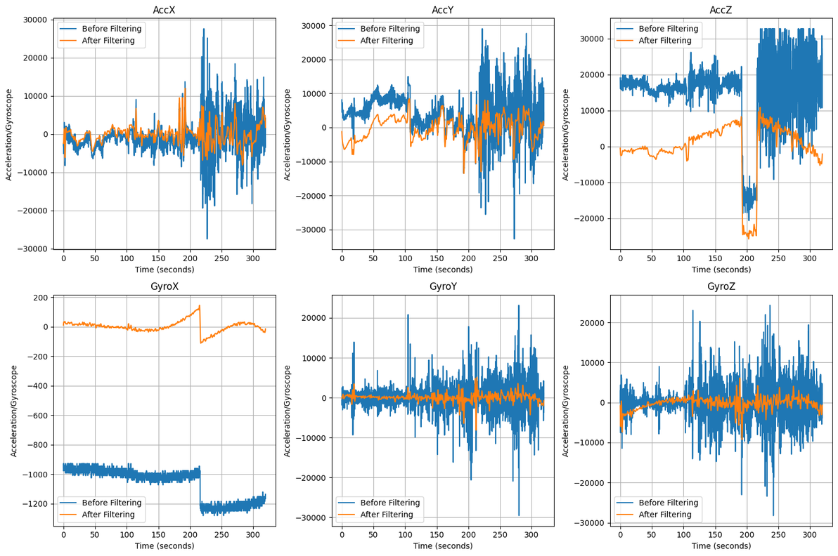
Train The Machine Learning Model
Data Pre
Processing
Recorded Data +
Synthetic Data
12Hz cut off low
Pass Filter
For model training, the following approaches were employed
SVM
Random Forest Classifier
Linear
RBF

Slide 6
Comparison of the Trained ML Models
Aspect | Linear SVM | RBF SVM | Random Forest Classifier
Decision Boundary | Linear (straight line, plane, hyperplane) | Nonlinear | Nonlinear
Kernel Function | Linear kernel (dot product of features) | RBF kernel (Gaussian function) | Not applicable (ensemble of decision trees)
Flexibility | Suitable for linearly separable data | Handles nonlinear relationships effectively | Handles nonlinear relationships effectively
Accuracy | 90% | 97% | 96%

Slide 7
Deploy ML Model to enable real-time prediction.
Using HTTP POST
Read Serial Data
Send to specified URL
Define End Point
Create Fast Api
application
Run FastApi App using Uvicorn
Parkinson Prediction
End POint
Loading
The Model
Saving prediction
model using pickle
Made Prediction and
Give the tremer level

Slide 8
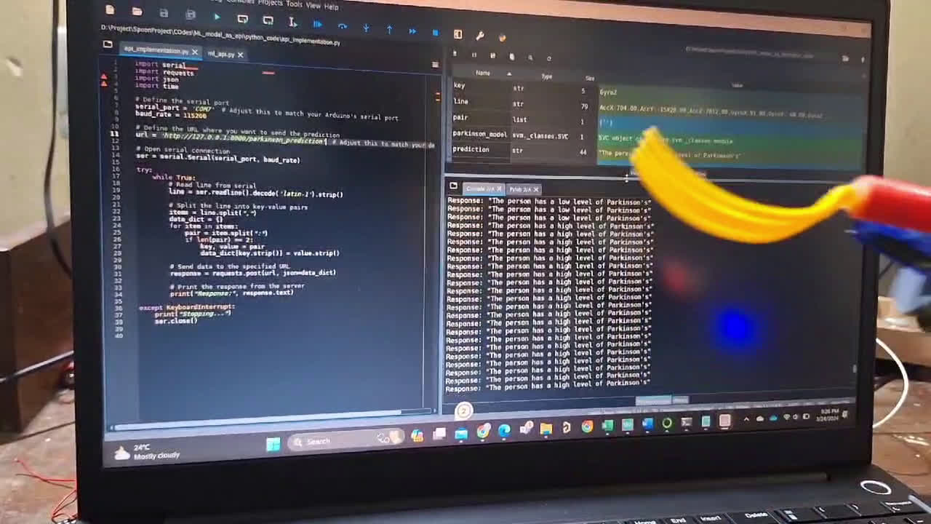
Demonstration of the severity level prediction.

Slide 9
The approach to changing PID values corresponding to the tremor level
Operating Mode | Axis | Parkinson Stage | Kp | Ki | Kd
Basic Operation Mode | X | No classification method | 1.05 | 0 | 0
 | Y | No classification method | 1.1 | 0 | 0
With Integrating ML | X | Low | 1 | 0 | 0
 |  | High | 1.1 | 0 | 0.005
 | Y | Low | 1 | 0 | 0
 |  | High | 1.2 | 0 | 0.001

